Slide 1
Introduction to Environmental Science: Issues and Values

Slide 2
This lecture will help you to understand:
The meaning of the term environment
The importance of natural resources
That environmental science is interdisciplinary
The scientific method and how science operates
Some challenges facing the global environment
Sustainability and sustainable development

Slide 3
Human and the world around us
Human change environment, often in ways not fully understand;
We depend completely on the environment for survival (Increased wealth, health, mobility, food)
As a consequence, the natural systems have been degraded (i.e., pollution, erosion and species extinction)
Thus, environmental changes threaten long-term health and survival and sustainability.
Environmental science is the study of:
How the natural world works
How the environment affects humans and vice versa

Slide 4
The meaning of the term Environment
Essentially, and its broadest sense, the word ‘environment’ embraces the conditions or influences under which any individual or thing exists, live, and develops. The surroundings can be placed into two categories:
The combination of physical conditions that affect and influence the growth and development of an individual or community.
The social, cultural, and institutional conditions that affect the nature of an individual or community.

Slide 5
Environment: the total of our surroundings
All the things around us with whom we interact:
Living things (Biotic)
Animals, plants, forests, fungi, etc.
Nonliving things (Abiotic)
Continents, oceans, clouds, soil, rocks
Our built environment
Buildings, human-created living centers
Social relationships and institutions
Notes:
1. The surroundings or conditions in which a person, animal, or plant lives or operates.
2. The setting or conditions in which a particular activity is carried on.
The sum total of all surroundings of a living organism, including natural forces and other living things, which provide conditions for development and growth as well as of danger and damage.
Word "environment" is most commonly used describing "natural" environment and means the sum of all living and non-living things that surrounds or influence the life of a living organism or community.

Slide 6
All of the biotic (organisms themselves, their food, interactions, and living things) and abiotic factors (sunlight, soil, air, water, climate, and pollution) that act on an organism, population, or ecological community and ultimately determine its form and survival;
b. the aggregate of social and cultural conditions that influence the life of an individual or community.

Slide 7
Key Themes
Human Population Problem
The continued rapid growth of human population will intensify all environmental problems and undermine our efforts to find effective solutions for them.
Human population growth is, in some important ways, the underlying issue of environmental problems. Much of the current environmental damage is directly or indirectly the result of the large number of people on the earth and our rate of increase.
Population growth and famine is related. Famine is one of the thing that happens when a human population exceeds its environmental resources.

Slide 8
Key Themes/Threads…………contd
An Urban World
Population increase, technological development, unemployment, are some of the reasons of increasing urban areas at a faster rate, particularly in the developing world. As urban areas expands, wetlands are filled in, forests cut, and soils covered over with pavements and buildings. It is estimated that the by 2015 the worlds will have 36 megacities, 23 of them in Asia.
As more and more people live in urban areas, efforts to solve environmental problems must focus on creating more livable urban environments and on increasing the harmony between urban development and natural landscapes.

Slide 9
People and Nature
People and nature are intimately integrated. Each affects the other. Two paths lie before us:
assume that environmental problems are the result of human action and the solution is simply to stop these actions. It has emphasized confrontation and emotionalism.
the 2nd path is to begin with a scientific analysis of an environmental controversy and to move from confrontation to cooperative problem solving. It accepts the connection between people and nature.

Slide 10
Key Themes/Threads
A Global Perspective
Due to the interconnectedness of the earth’s ecosystems and the wide-ranging effects of human intervention with them, scientists and citizens alike must adopt a global perspective in order to understand and ameliorate environmental problems.
Awareness of how people at a local level affect the environment globally gives credence to the Gaia hypothesis. Future generations will need a global perspective on environmental issues.

Slide 11
Key Themes/Threads
Sustainability and carrying capacity
Sustainability must be achieved, but we are unclear at present how to achieve it, in part because the word is used to mean different things.
Sustainability refers to resources and their environment. Sustainable development typically means that a society can continue to develop its economy and its social institutions and also maintain its environment for an indefinite time.
Carrying capacity is a concept related to sustainability. It is usually defined as the maximum number of individuals of a species that can be sustained by an environment without decreasing the capacity of the environment to sustain that amount in the future.

Slide 12
Sustainability and carrying capacity…
It is important that we use our natural resources in a sustainable way for continued human benefit. However, we face the possibility of change at a scale that may be beyond current socio-political capabilities…

Slide 13
Key Themes/Threads…………contd
Science and Values
Deciding what to do about an environmental problem involves both values and science.
Placing a value on various aspects of the environment requires knowledge and understanding of the science but also depends on our judgments concerning the uses and aesthetics of the environment and on our moral commitments to other living things and to future generations.
Ecological knowledge provides options for environmental action, choices are determined in part by our values; science tells us what we can do, while our values help us determine what we should do.

Slide 14
Placing a value on the environment
How do we place a value on any aspect of our environment?
The value of the environment is based on eight justifications:
Aesthetic, creative, recreational, inspirational, moral, cultural, ecological, and utilitarian.
The utilitarian justification sees some aspects of the environment as valuable because it benefits individuals economically or is directly necessary to human survival. E.g. mangrove swamps provide shrimp.
The ecological justification is that an ecosystem is necessary for the survival of some species of interest to us, or that the system itself provides some benefit. (e.g. mangrove swamps provide habitat for marine fish.)

Slide 15
Placing a value on the environment …..
Aesthetic justification has to do with appreciation of the beauty of nature. (e.g. many people find wilderness scenery beautiful and would rather live in a world with wilderness than without it).
Nature is an aid to human creativity/inspiration (creative/inspiration justification).
Moral justification has to do with the belief that various aspects of the environment have a right to exist and that is our moral obligation to allow them to continue or help them to persist.

Slide 16
The six key themes lead to the following questions:
Human populations
What is more important: the quality of life of a person alive today or the quality of life of future generations?
Sustainability
What is more important: Abundant resource today- as much as we want and can obtain- or the persistence of these resources for future generations?

Slide 17
The six key themes lead to the following questions: contd…
Global perspective:
What is more important: the quality of your local environment or the quality of the global environment- the environment of the entire planet?
Urban world:
What is more important: Human creativity and innovation, including arts, humanities, or science, or the persistence of certain endangered species? Must this always be a trade-off or are there ways to have both?

Slide 18
The six key themes lead to the following questions: contd…
People and nature:
If people have altered the environment for much of the time our species has been on earth, what then is “natural” ?
Science and values:
Does nature know best, so that we never have to ask what environmental goal we should seek, or do we need knowledge about our environment, so that we can make the best judgments given available information.

Slide 19
Natural resources: vital to human survival
Natural resources = substances and energy sources needed for survival
What is a natural resource?
- A natural resource is anything obtained from the environment to meet human needs and wants. Example include food, water, manufactured goods;
- Some resource, such as solar energy, fresh air, wind, fresh surface water, fertile soil and wild plants are directly available for use;
- Other resources such as petroleum, iron, groundwater are not directly available. They become useful to us only with some effort and technological activities.

Slide 20
The classification of natural resources:
Renewable resources:
Perpetually available - solar energy; it is renewed continuously. Solar energy is expected to last at least 6 billion years as the sun completes its life cycle;
Renew themselves over short periods - can be replenished fairly rapidly (hours to several decades) through natural processes as long as it is not used up faster than it is replaced. Example- forests, water, soil, etc.
Non-renewable resource:
Resources that exist in a fixed quantity or stock in the earth’s crust are called non-renewable resources. On a time scale of millions to billions of year, geological processes can renew such resources. Example include- fossil fuel.

Slide 21
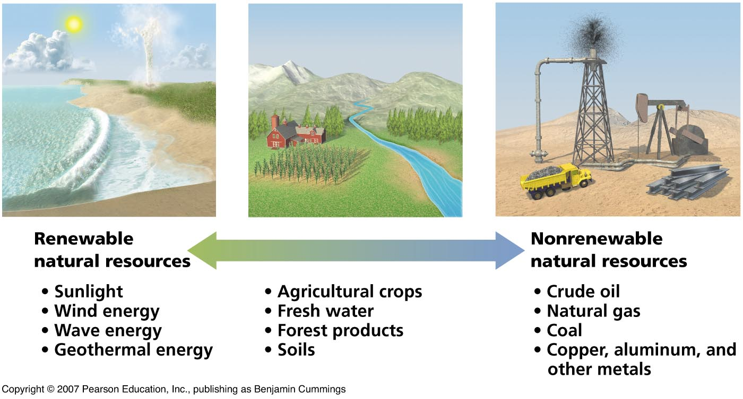
Natural resources: vital to human survival
Natural resources = substances and energy sources needed for survival
Renewable resources:
Perpetually available: sunlight, wind, wave energy
Renew themselves over short periods: timber, water, soil
These can be destroyed
Non-renewable resources: can be depleted
Oil, coal, minerals

Slide 22
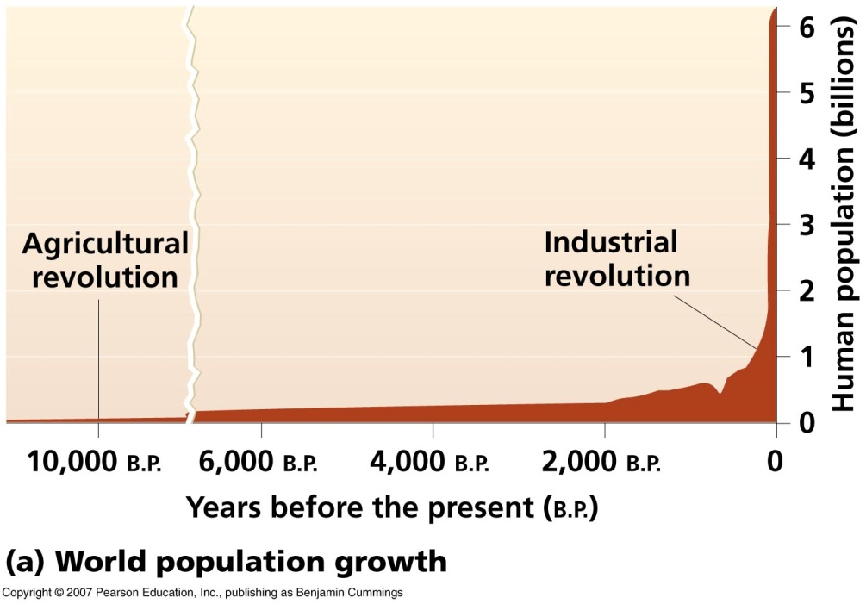
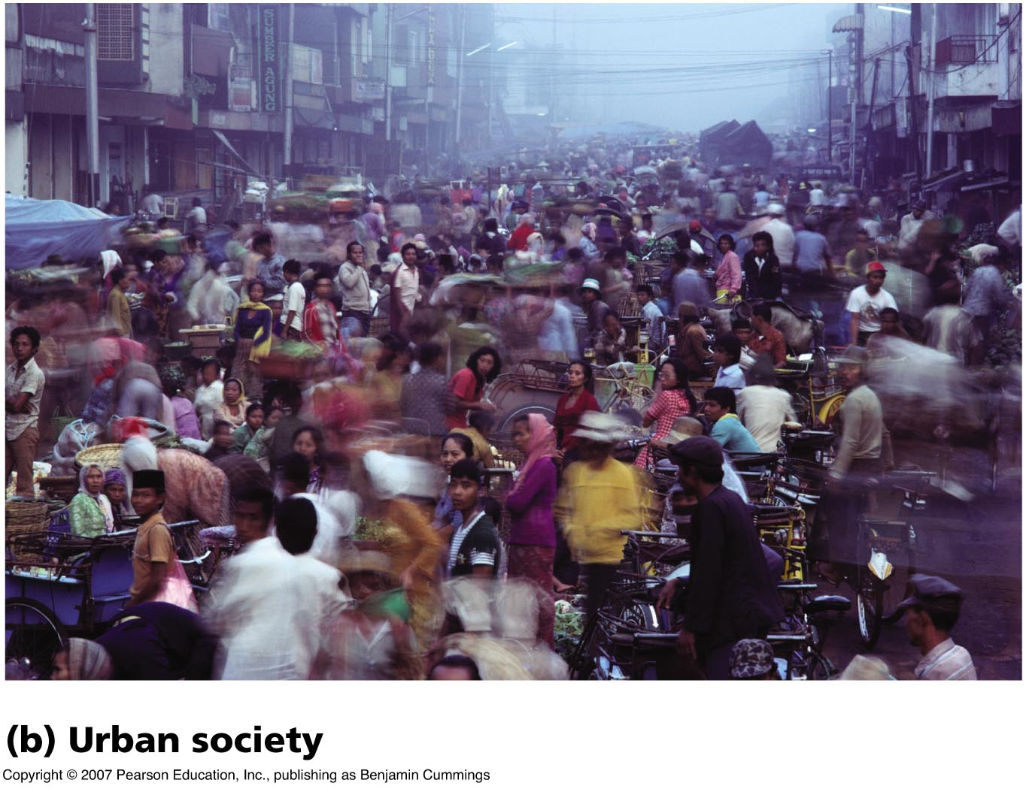
Global human population growth
More than 7.5 billion humans
Why so many humans?
Agricultural revolution
Stable food supplies
Industrial revolution
Urbanized society powered by fossil fuels
Sanitation and medicines
More food

Slide 23
Thomas Malthus and human population
Thomas Malthus
Population growth must be restricted, or it will outstip food production
Starvation, war, disease
Neo-Malthusians (e.g., Paul Ehrlich, Garrett Hardin, Lester Brown, David Pimentel) have revived some of his ideas. Namely:
Population is an important issue because the planet is already overpopulated.
Population growth puts unsustainable pressure on the earth and its limited resources.
One of these days, we will overstep the Earth’s ability to support us. Therefore, we need to control population soon.
Notes:
Thomas Malthus is a key figure in demography; he thought that human population increases much faster than agricultural production, thus the end result is starvation, disease, and war.
The ideas that Thomas Malthus developed came before the industrial revolution and focuses on plants, animals, and grains as the key components of diet. Therefore, for Malthus, available productive farmland was a limiting factor in population growth. With the industrial revolution and increase in agricultural production, land has become a less important factor than it was during the 18th century.

Slide 24
Garrett Hardin’s Tragedy of the Commons
The concept of the Tragedy of the Commons is extremely important for understanding the degradation of our environment. The concept was clearly expressed for the first time by Garrett Hardin in his famous article in Science in 1968, which is "widely accepted as a fundamental contribution to ecology, population theory, economics and political science."
Solving commons problems involves two distinct elements:
Restricting access, and
Creating incentives (usually by assigning individual rights to, or shares of, the resource) for users to invest in the resource instead of overexploiting it.

Slide 25
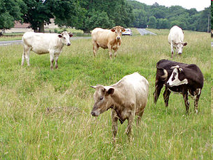
Garrett Hardin’s Tragedy of the Commons…
Unregulated exploitation leads to resource depletion:
Soil, air, water;
Resource users are tempted to increase use until the resource is gone;
What are the Solutions?
Private ownership?
Voluntary organization to enforce responsible use?
Governmental regulations?
Declaration of World heritage sites, IPAC?
Fig: Cows on Selsley Common. The tragedy of the commons is a useful parable for understanding how overexploitation can occur .

Slide 26
Population & consumption
Human population growth exacerbates all environmental problems:
The growth rate has slowed, but we still add more than 200,000 people to the planet each day;
Our consumption of resources has risen even faster than our population growth:
Life has become more pleasant for us so far;
However, rising consumption amplifies the demands we make on our environment.

Slide 27
Consumption – another measure of population + resources
The US consumes more per person (capita) than people in developing countries do.
US also produce more, that is sold and distributed world wide, per capita than any country in the world. The US produces:
32% of all international trade in wheat,
68% of all coarse grains, and
17% of all rice
But this means more concentrated energy, resource use and waste/pollution in US than elsewhere in the world.

Slide 28
Global Food Needs & Consumption Trends
Population and income are the major factors in determining food consumption.
World food demand is growing at a rate of 2% per year – 1.8% of this because of population increase and 0.2% because of rising incomes.
20% of the global population consumes 70% of its material resources and possesses 80% of the wealth. (WWF);
The majority of this 20% in centered in Canada, USA, Saudi Arabia, Australia, and Japan. (WWF)

Slide 29
Imbalanced consumption vs. population
Poorest countries (Africa, Asia, and Latin America) 2.5% increase in demand, but only a 1.9% increase in supply;
These countries typically depend on US, Canadian and Australian grain supplies.

Slide 30
Food issues around the World
In 75 nations, per capita food production has declined over the past 15 years.
Among the larger countries where shrinking cropland per person threatens future food security are Nigeria, Ethiopia, Pakistan, and Bangladesh, all countries with weak family planning programs.
For example, as Nigeria's population goes from 111 million to a projected 244 million in 2050, its grainland per person will shrink from 0.15 hectares to 0.07 hectares.

Slide 31
Increasing the World’s Food Supply. ..How?
Crop Yields
1. Great disparity between countries
a. Wheat Production:
Pakistan = 2.1 metric tons per hectare
Germany = 6.9 metric tons per hectare
b. Corn Production:
India = 1.6 metric tons per hectare
U.S. = 7.1 metric tons per hectare
How could production in these countries be increased?

Slide 32
1. “Green Revolution” 1970’s
The introduction of high yielding varieties of wheat and rice in Asia doubled or tripled yields… but with environmental and social consequences

Slide 33
2. Land Area
1. Land surface = 25% of the earth, the rest is water, polar icecaps
Africa and South America have the largest areas of potentially arable land.
Africa currently farms 20% of its potentially arable land.
South America farms 10%
The U.S., Canada, Australia and New Zealand have about 1 billion acres of land that could be farmed.

Slide 34
3. Food from the Sea
1. Aquatic products are a very important food source in Japan, Norway, Spain, Iceland, Portugal and Southeast Asia
2. However, fish make up only 1% of the world’s caloric intake and only 6% of all protein
3. Long-term plans for “Farming the Sea” will do little to solve world hunger problems.

Slide 35
Food production is not the problem – is food distribution the problem?
a. inadequate infrastructure –roads, communication, fuel
b. lack of access to scientific knowledge (research and extension service non-existent)
c. government interference in market forces – wars, political turmoil, changing government structure, corruption.
d. But recent study suggests that distribution of food might not be the problem…instead an unequal distribution of wealth!

Slide 36
Carrying Capacity
Carrying capacity refers to the number of individuals who can be supported in a given area within natural resource limits, and without degrading the natural social, cultural and economic environment for present and future generations.
The carrying capacity for any given area is not fixed. It can be altered by improved technology, but mostly it is changed for the worse by pressures which accompany a population increase.
As the environment is degraded, carrying capacity actually shrinks, leaving the environment no longer able to support even the number of people who could formerly have lived in the area on a sustainable basis. No population can live beyond the environment's carrying capacity for very long.

Slide 37
Carrying Capacity: Two Patterns for Species
Many animal species have been studied with respect to a specific area’s carrying capacity. Starting from a low population level there are two quite different patterns which describe how various species reach carrying capacity: Sigmoid pattern & Peak phenomena pattern.
According to Sigmoid pattern population increase rapidly while food and habitat are abundant, and then slow down as regulatory factors such as lower birth rate and reduced food availability come into play. As the rate of population growth slows down to zero, the population reaches a fairly stable level. This pattern is referred to as K (for constant) selected species.

Slide 38
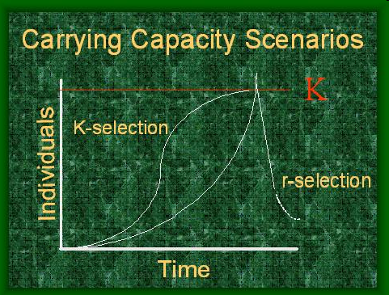
Carrying Capacity: For Species
According to the Peak phenomena pattern the same regulatory factors do not come into play and the population increases rapidly to the point where it exhausts the resources upon which it depends. At this point, mortality becomes the primary regulatory factor, and the population collapses to a low level. When resources are replenished population begins to rise again; this process is repeated in a boom and bust cycle. This is referred to as the “r-selected” species.

Slide 39
Human Application
The concept of carrying capacity was applied to human populations in the 1960’s. It was noted that the consumption habits of humans are much more variable than those of other animal species, making it considerably more difficult to predict the carrying capacity of the earth for human beings.
There have been a large number of published articles estimates for the human carrying capacity of the earth:
they range from a low of one half billion people to a staggering 800 billion. Many of these estimates are more ideologically based than determined by scientific principles.
If consumption level per capita is higher, then a smaller population can be supported. If technologies increase or decrease overall consumption, then they also affect the carrying capacity.

Slide 40
Recovery vs. Reduced Capacity
If the population is reduced because of a 1-time catastrophe—e.g. a long drought—then over time it will recover to its former size.
But if the overall environment is reduced—e.g. half the forest is cut down—then the population adjusts to a new, lower carrying capacity.

Slide 41
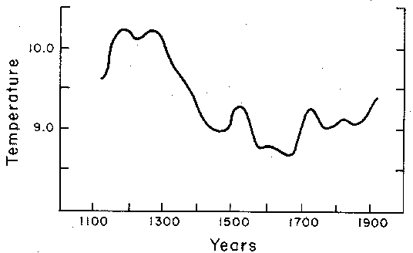
Response to Plague & Little Ice Age
Human populations have not always increased continuously. Famines, disease, and climate change can stress any population—even human populations.

Slide 42
Carrying Capacity………..contd
Carrying capacity tells us that the biophysical limits of our environment are key in determining how many human can survive at what levels of consumption.
The realization of difficulties in assessing the carrying capacity of Humans, gave rise to The IPAT Equation which pointed out that carrying capacity for humans was a function not only of population size, but also of differing levels of consumption, which in turn are affected by the technologies involved in production and consumption.

Slide 43
The first model Population, Consumption, and Environmental Impact
Biologist Paul R. Ehrlich and physicist John P. Holdren proposed the first simple model IPAT:
I = P x A x T
Here,
I = environmental Impact
P = number of people
A = affluence or consumption of persons
T = resources used/waste produced

Slide 44
Sticking them together
If you increase the number of people OR the consumption per person OR the resources used (producing waste) you increase the Impact;
Therefore, the more people we get that live at a higher level (and consume more per person) the greater the impact we have on the environment.
This is absolutely a simple equation but an important concept to think about the sustainability issue.

Slide 45
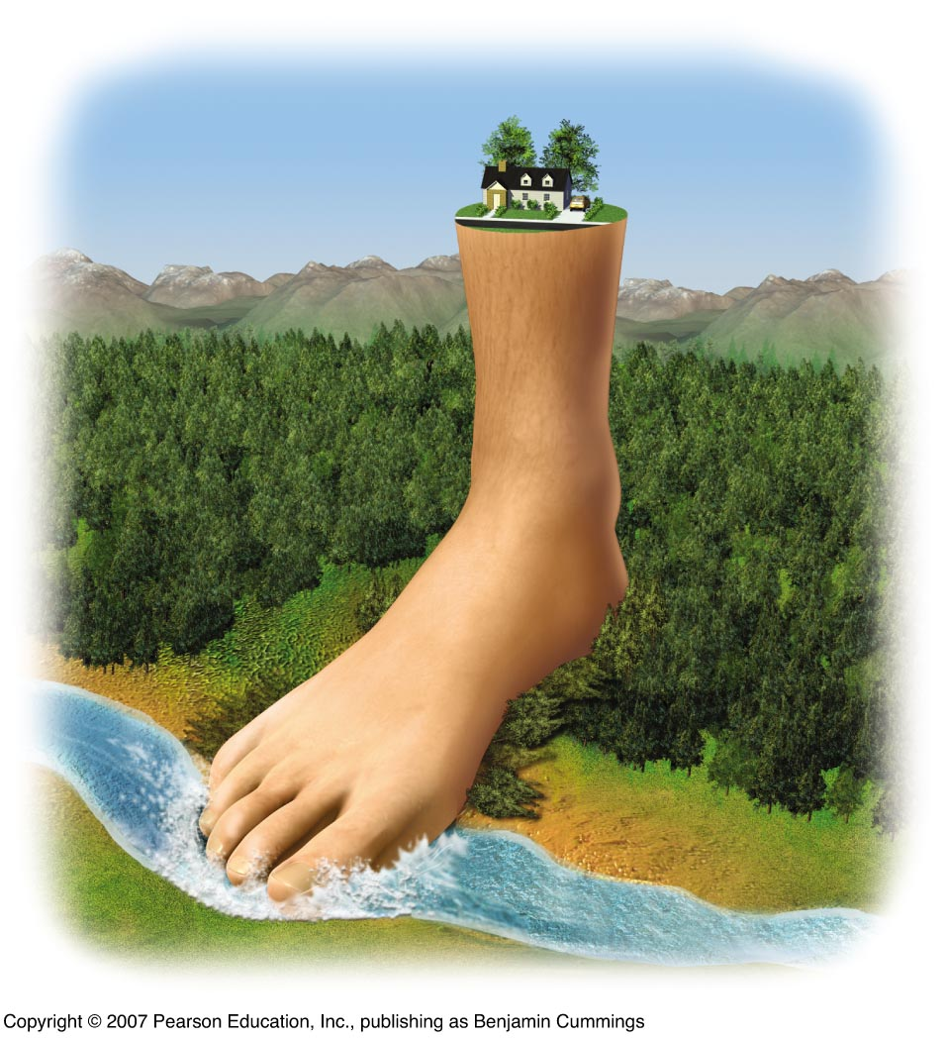
The ecological footprint is a measure of human demand on the Earth's ecosystems. It compares human demand with planet Earth's ecological capacity to regenerate. It represents the amount of biologically productive land and sea area needed to regenerate the resources a human population consumes and to absorb and render harmless the corresponding waste.
Overshoot: humans have surpassed the Earth’s carrying capacity:
The “ecological footprint”
We are using 30% more of the planet’s resources than are available on a sustainable basis!

Slide 46
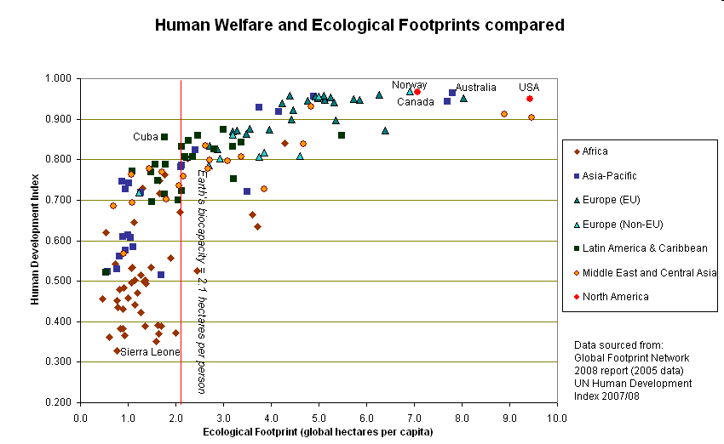

Slide 47
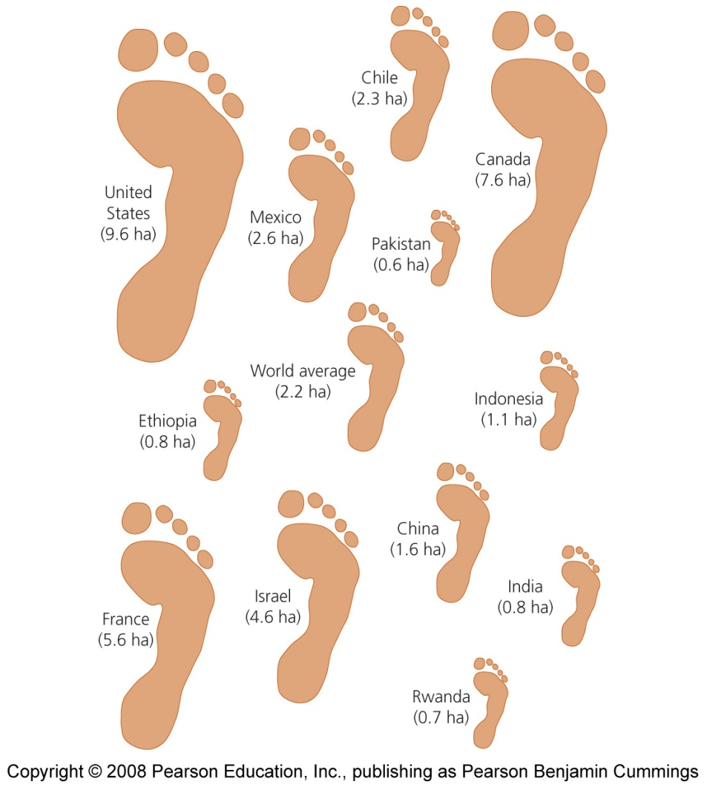
Ecological footprints are not all equal
The ecological footprints of countries vary greatly:
The U.S. footprint is almost 5 times greater than the world’s average;
Developing countries have much smaller footprints than developed countries.

Slide 48
Ecological footprints
Wackernagel and Rees originally estimated the available biological capacity for 6.5 billion people on Earth.
At that time (1994) it was about 1.3 hectares per person, which is smaller than the 1.8 global hectares published for 2006.
The U.S. footprint per capita was 9.0 gha, and that of Switzerland was 5.6 gha per person, while China's was 1.8 gha per person.

Slide 49
Ecological footprints: methodological constraints
However, there have been differences in the methodology used by various ecological footprint studies. Examples include:
how sea area should be counted, how to account for fossil fuels, which data sources used, when average global numbers or local numbers should be used when to look at a specific area, how space for biodiversity should be included, etc.

Slide 50
Ecological footprints
The total world ecological footprint is 2.6 global hectares per capita. The ecological reserve, or bio-capacity – the amount of land available for production, is 1.8 global hectares per person, a deficit of 0.8 global hectares per capita.
The tool can inform policy by examining to what extent a nation uses more (or less) than is available within its territory, or to what extent the nation's lifestyle would be replicable worldwide. The footprint can also be a useful tool to educate people about carrying capacity and over-consumption, with the aim of altering personal behaviour.

Slide 51
Per capita Co₂ emissions (tons) & Ecological Footprint (gha/pers) in 2006
Country | Rank | Co₂ emission | EF
Bangladesh | 181 | 0.3 | 0.5
UK | 41 | 9.4 | 6.1
Netherlands | 27 | 10.3 | 4.6
USA | 9 | 19 | 9.0
United Arab Emirates | 2 | 32.8 | 10.3
Qatar | 1 | 56.2 | 9.7

Slide 52
Calculating Ecological Footprints
Why do you think the ecological footprint for the people in Bangladesh is so small? Why is it so large for people living in the United States?
Go to the online footprint calculator http://www.myfootprint.org/en/ and take the test to determine your own personal ecological footprint.
Name three actions that you would like to follow to reduce your ecological footprint.

Slide 53
GAIA HYPOTHESIS The Gaia hypothesis is an ecological hypothesis that proposes that living and nonliving parts of the earth are a complex interacting system that can be thought of as a single organism. Named after the Greek earth goddess, the hypothesis suggests that all living things have a regulatory effect on the Earth's environment that promotes overall life. The Gaia hypothesis was first scientifically formulated in 1960s by the independent research scientist Dr. James Lovelock, as a consequence of his work for NASA on methods of detecting life on Mars.

Slide 54
GAIA HYPOTHESIS
The truly startling component of the Gaia hypothesis is the idea that the Earth is a single living entity.
This idea is certainly not new. James Hutton (1726-1797), the father of geology, once described the Earth as a kind of super-organism. And right before Lovelock, Lewis Thomas, a medical doctor and skilled writer, penned these words in his famous collection of essays, The Lives of a Cell.

Slide 55
GAIA HYPOTHESIS
This theory is important to Physical Geography and other branches of Earth Sciences for the following reasons:
The Gaia theory suggests that the abiotic and biotic environment is made up of many complex interrelationships;
Many of these complex interrelationships are quite delicate and may be altered by human activity to a breaking point; and
The theory suggests that humans must learn to respect Gaia by reducing their intentional modification of the Earth's abiotic and biotic components.

Slide 56
We face challenges in agriculture
Expanded food production led to increased population and consumption
It’s one of humanity’s greatest achievements, but at an enormous environmental cost
Nearly half of the planet’s land surface is used for agriculture
Chemical fertilizers
Pesticides
Erosion
Changed natural systems

Slide 57
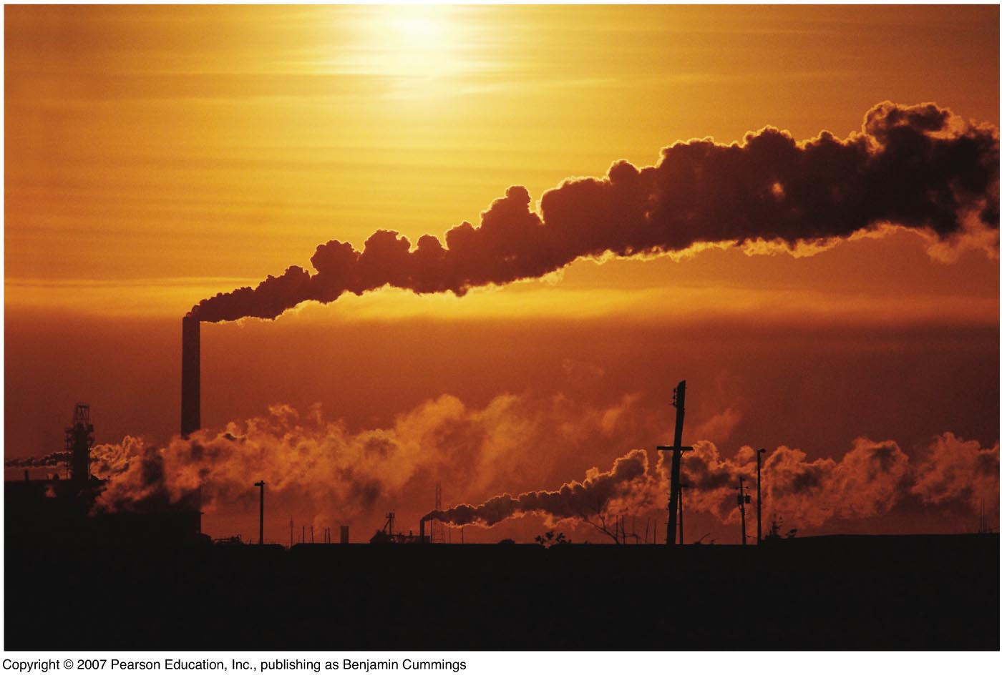
We face challenges in pollution
Waste products and artificial chemicals used in farms, industries, and households
Each year, millions of people die from pollution

Slide 58
Pollution Source
Naturally (from volcanic eruptions),
human activities (from burning coal),
Industrialized agriculture.
There are two types of pollutaion sources:
Point sources, where pollutants come from single, identifiable sources. Examples are the (1) smokestack of a coal-burning power plant, (2) drainpipe of a factory, or (3) exhaust pipe of an automobile.
Non-point sources, where pollutants come from dispersed (and often difficult to identify) sources. Examples are (1) runoff of fertilizers and pesticides (from farmlands, golf courses, and suburban lawns and gardens) into streams and lakes and (2) pesticides sprayed into the air are blown by the wind into the atmosphere.

Slide 59
Pollutants may be:
Degradable pollutants: can be decomposed, removed, or consumed and thus reduced to acceptable level by natural physical, chemical, and biological processes.
Non-degradable pollutants: cannot be broken down by natural processes. e.g., the toxic elements, lead and mercury.
Biodegradable pollutants. Complex chemical pollutants broken down (metabolized) into simpler chemicals by living organisms (usually by specialized bacteria). Example: human sewage in river is biodegradable fairly quickly by bacteria if the sewage is not added faster than it can be broken down.

Slide 60
We face challenges in climate
Scientists have firmly concluded that humans are changing the composition of the atmosphere;
The Earth’s surface is warming:
Melting glaciers
Rising sea levels
Impacted wildlife and crops
Increasingly destructive weather
Since the Industrial Revolution, atmospheric carbon dioxide concentrations have risen by 37%, to the highest level in 650,000 years.

Slide 61
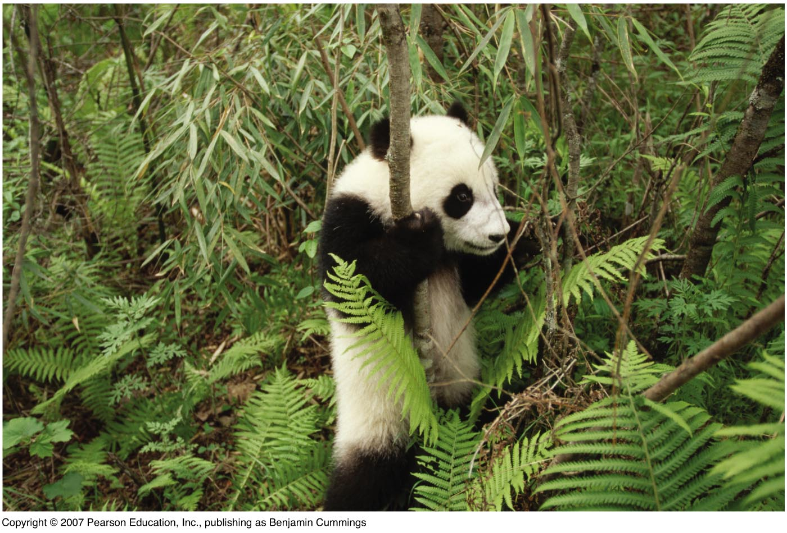
We face challenges in biodiversity
Human actions have driven many species extinct, and biodiversity is declining dramatically;
We are at the onset of a mass extinction event.
Biodiversity loss may be our biggest environmental problem; once a species is extinct, it’s gone forever

Slide 62
The Millennium Ecosystem Assessment
The most comprehensive scientific assessment of the condition of the world’s ecological systems.
Major findings:
Humans have drastically altered ecosystems;
These changes have contributed to human well-being and economic development, but at a cost of WHAT?
Environmental degradation could get much worse;
Degradation can be reversed, but it requires time and knowledge of ecological science.

Slide 63
Our energy choices will affect our future
The lives we live today are due to fossil fuels
Machines
Chemicals
Transportation
Products
Fossil fuels are one-time resource; supplies will certainly decline fast;
We have used up ½ of the world’s oil supplies; how will we handle this imminent fossil fuel shortage?

Slide 64
Sustainable solutions exist
We must develop solutions that protect both of our quality of life and the environment:
Organic agriculture
Technology
Reduces pollution
Biodiversity
Protect species
Waste disposal
Recycling
Alternative fuels

Slide 65
Are things getting better or worse?
Many people think environmental conditions are better
Cornucopians: Human ingenuity will solve any problem
Some people think that things are much worse in the world
Cassandras: predict doom and disaster
How can you decide who is correct?
Are the impacts limited to humans, or are other organisms or systems involved?
Are the proponents thinking in the long or short term?
Are they considering all costs and benefits?

Slide 66
Sustainability: a goal for the future
How can humans live within the planet’s means?
Humans cannot exist without functioning natural systems
Sustainability
Leaves future generations with a rich and full Earth
Conserves the Earth’s natural resources
Maintains fully functioning ecological systems
Sustainable development: the use of resources to satisfy current needs without compromising future availability of resources

Slide 67
Will we develop in a sustainable way?
The triple bottom line: sustainable solutions that meet
Environmental goals
Economic goals
Social goals
Requires that humans apply knowledge from the sciences to
Limit environmental impacts
Maintain functioning ecological systems

Slide 68

Current Emphasis
Sustainability Emphasis
Pollution cleanup
Pollution prevention
Waste disposal
(bury or burn)
Waste prevention
Protecting species
Protecting habitat
Environmental
degradation
Environmental restoration
Increasing resource use
Less resource waste
Population growth
Population stabilization
Depleting and degrading natural capital
Protecting natural capital

Slide 69
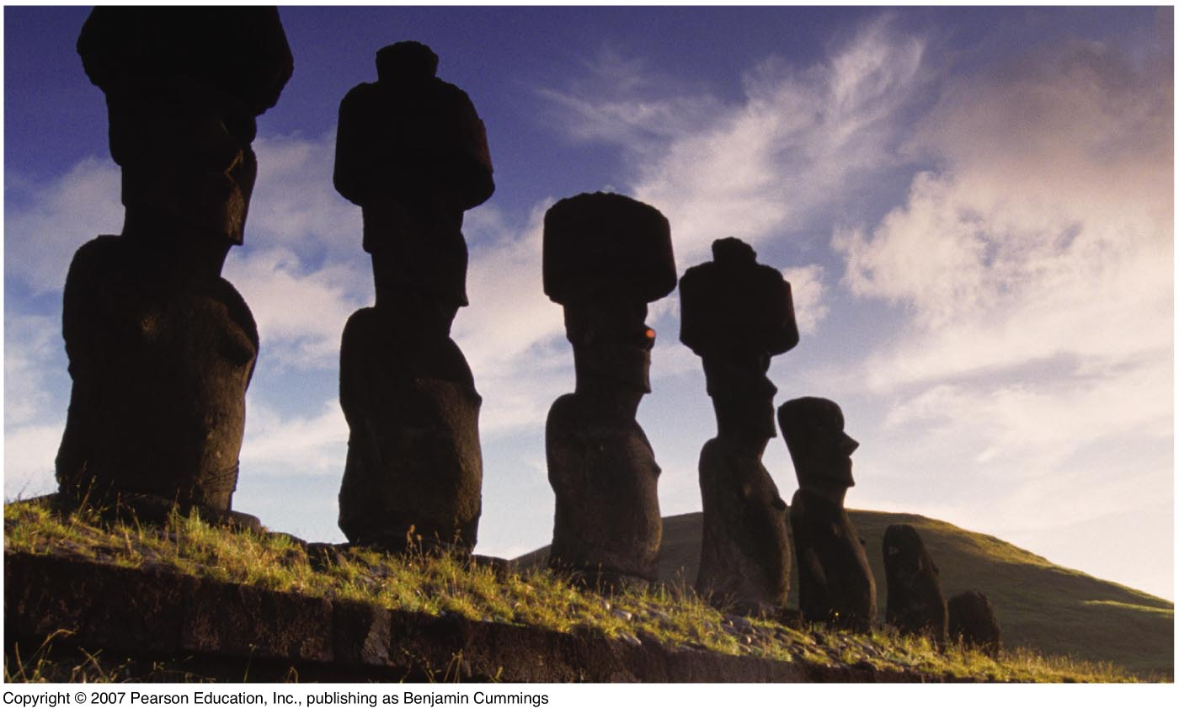
Environmental science
… can help us avoid mistakes made by past civilizations.

Slide 70
Environmental science: how does the natural world work?
Environmental science is an interdisciplinary science that uses concepts and information from natural sciences such as ecology, biology, chemistry and geology and social sciences such as economics, politics and ethics to help us understand-
- how the earth works;
- how are we affecting the earth’s life-support systems
(environment);
- how to deal with the environmental problems that we face.

Slide 71
Environmental Science Environmental science, the study of the interactions among the physical, chemical and biological components of the environment. Environmental science is the science of the relationship between man and the natural world in which he lives. Environmental Science provides an integrated, quantitative, and interdisciplinary approach to the study of environmental systems. Environmental study Environmental study is the systematic study of human interaction with their environment. It is a broad field of study that includes the natural environment, built environments, social environments, organizational environments, and the sets of relationships between them.

Slide 72
What is an “environmental problem”?
The perception of what constitutes a problem varies between individuals and societies:
Ex.: DDT, a pesticide
In developing countries: welcome because it kills malaria-carrying mosquitoes
In developed countries: not welcome, due to health risks. Also Asbestos.

Slide 73
ENVIRONMENTAL ETHICS
Environmental ethics is the part of environmental philosophy which considers the ethical relationship between human beings and the natural environment. It exerts influence on a large range of disciplines including law, sociology, theology, economics, ecology and geography.
There are many ethical decisions that human beings make with respect to the environment. For example:
•Should we continue to clear forests for the sake of human consumption?
•Should we continue to make gasoline powered vehicles, depleting fossil fuel resources while the technology exists to create zero-emission vehicles?
•What environmental obligations do we need to keep for future generations?

Slide 74
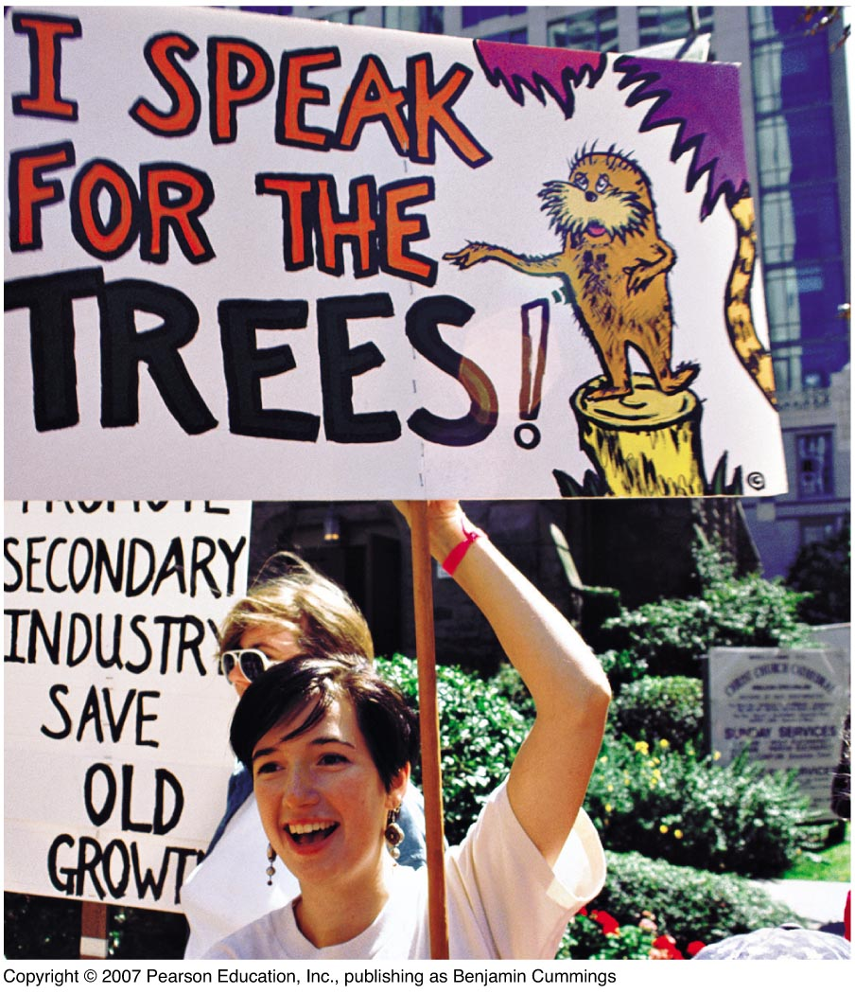
Environmental science is not environmentalism
Environmentalism
A social movement dedicated to protecting the natural world

Slide 75
Importance of Environmental Science (ES)
ES is important for economy and welfare of human society;
ES is primarily concerned with how humanity affects and in turn is affected by other living organisms and the non-living physical environment;
It helps us in careful handling of the issues like pollution, overexploitation of natural resources, food security and sustainable development;
ES helps us to find ways and means to maintain the ecological balance;

Slide 76
Importance of Environmental Science (ES)..
It demonstrates how man can derive benefits from environment without destroying it;
It trains us to conserve our fast depleting natural resources;
It helps to understand different food chain and ecological balance in nature.

Slide 77
The nature of science
Science:
A systematic process for learning about the world and testing our understanding of it;
A dynamic process of observation, testing, and discovery;
Science is essential:
To sort fact from fiction
Develop solutions to the problems we face.

Slide 78
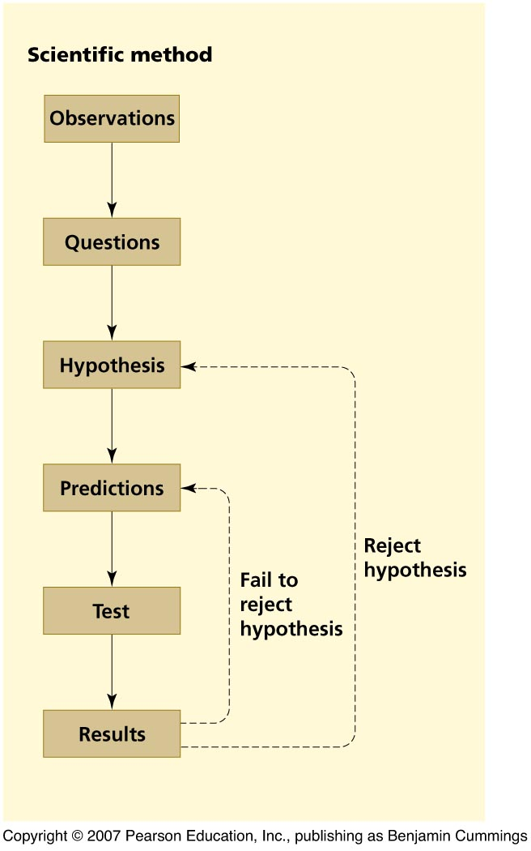
The scientific method
A technique for testing ideas with observations
Assumptions:
The universe works according to unchanging natural laws;
Events arise from causes, and cause other events;
We use our senses and reason to understand nature’s laws

Slide 79
The scientific method……
A scientist makes an observation and asks questions of some phenomenon;
The scientist formulates a hypothesis, a statement that attempts to explain the scientific question.
The hypothesis is used to generate predictions, which are specific statements that can be directly and unequivocally tested.
The test results either support or reject the hypothesis

Slide 80
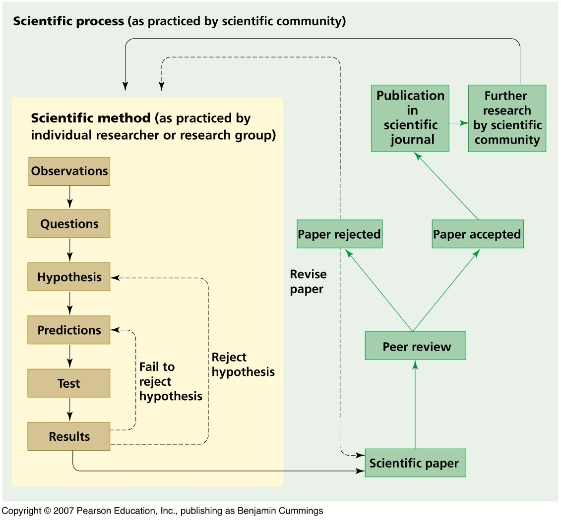
The scientific process is part of a larger process
The scientific process includes peer review, publication, and debate;
A consistently supported hypothesis becomes a theory, a well-tested and widely accepted explanation.

Slide 81
Science does not deal with things that cannot be tested by observation:
the ultimate purpose of life
the existence of a supernatural being
standards of beauty or issues of good and evil.

Slide 82
The Precautionary Principle
It can be difficult to prove with absolute certainty how human activities lead to local and global environmental problems;
Environmental problems are complex and interrelated with issues specific to a given region.
When there is a threat of serious environmental damage, we should not wait for certain scientific proof before taking steps to prevent potential harm.
Notes:
Precaution – the “precautionary principle” or “precautionary approach” – is a response to uncertainty, in the face of risks to health or the environment. In general, it involves acting to avoid serious or irreversible potential harm, despite lack of scientific certainty as to the likelihood, magnitude, or causation of that harm.
Precaution is now an established principle of environmental governance, prominent in law, policy and management instruments at international, regional and domestic level, across such diverse areas as pollution, toxic chemicals, food and phytosanitary standards, fisheries management, species introductions and wildlife trade.

Slide 83
The Precautionary Principle…..
However, we need to examine the benefits and costs of taking a particular action versus taking no action;
Therefore, a regional approach to solving environmental problems is ideal.
The Precautionary Principle is a proactive tool.

Slide 84
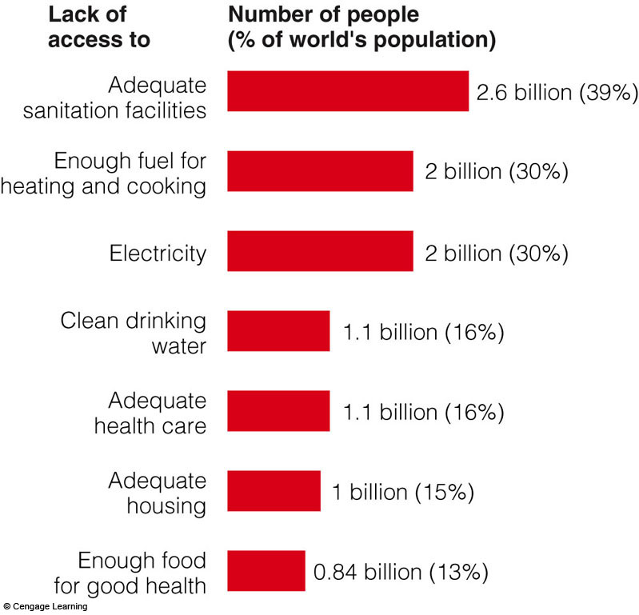
Some Harmful Results of Poverty

Slide 85
Causes of Environmental Problems
Population growth;
Wasteful and unsustainable resource use;
Poverty;
Excluding the environmental costs of resource use from the market prices of goods and services; and
Trying to manage nature with insufficient knowledge.
Notes:
Figure 1.11
Natural capital degradation: five basic causes of the environmental problems we face. QUESTION: Can you think of any other basic causes?

Slide 86
The Global Nature of Environmental Concerns
The first worldwide meeting of heads of state directed towards the environment took place at the Earth Summit (United Nations Conference on Environment and Development) in Rio de Janeiro in 1992.
Most countries at the conference signed agreements on sustainable development and biodiversity.

Slide 87
The Global Nature of Environmental Concerns
In 1997, representatives from 125 nations met in Kyoto, Japan for the Third Conference of the United Nations Framework Convention on Climate Change.
The Kyoto Protocol is viewed as one of the most important steps to date in environmental protection and international diplomacy.

Slide 88
What have we learnt?
Human population is a major contributor to environmental degradation;
Economic development and urbanization have potential environmental consequences;
Unsustainable use of resources causes environmental problems;
Local changes can have global impacts & vice versa;
Environmental issues requires value judgment & scientific understanding;
Environmental science can help us find balanced solutions to environmental problems.

Slide 89
How Would You Vote?
Is the society you live in on an unsustainable path?
a. Yes: Without readily available green products and services, converting to a sustainable society is unrealistic.
b. Not entirely: I'm doing what I can to improve sustainability, including recycling and using less energy.

